Slide 1

NET2201 COMPUTER NETWORKS
Design and Implementation of a Small-to-Medium Enterprise Network
PRACTICAL GROUP 2
Chan Xiang Wei · Teo Wan Yin · Tey Yu Shan · Chia Li Ying · Arjoona Kumaran
Notes:
1

Slide 2
COMPLETED PROJECT
Project Overview
THE STARTING PROBLEM
WHAT WE DELIVERED
Flat, unsegmented network
Every device shared one broadcast domain
No isolation between departments
Staff, students, and guests all mixed together
No automation or redundancy
Manual IP config, single points of failure
No access-layer protection
4 VLANs (Staff, Student, Guest, Management) with Router-on-a-Stick inter-VLAN routing
Centralized DHCP with reserved/excluded ranges per VLAN
LACP EtherChannel + PVST+ for loop-free, redundant switch links
8 access-layer security features (2x the required minimum)
SSH-only management on a dedicated Management VLAN
Verified internet access via a simulated ISP with static routing
NET2201 · Design and Implementation of a Secure SME Network
2
Notes:
2

Slide 3
How We Achieved It
01
02
03
04
05
Design
Segment
Automate
Harden
Verify
Two-tier topology: access switches + core router + simulated ISP
Built VLANs, 802.1Q trunking, and Router-on-a-Stick routing
Centralized DHCP pools with gateway exclusions per VLAN
LACP EtherChannel, PVST+, and 8 access-layer security features
15 tests executed in Packet Tracer, then repeated on physical devices
Built first in Packet Tracer, then re-implemented and re-verified on physical Cisco hardware.
NET2201 · Design and Implementation of a Secure SME Network
3
Notes:
3

Slide 4
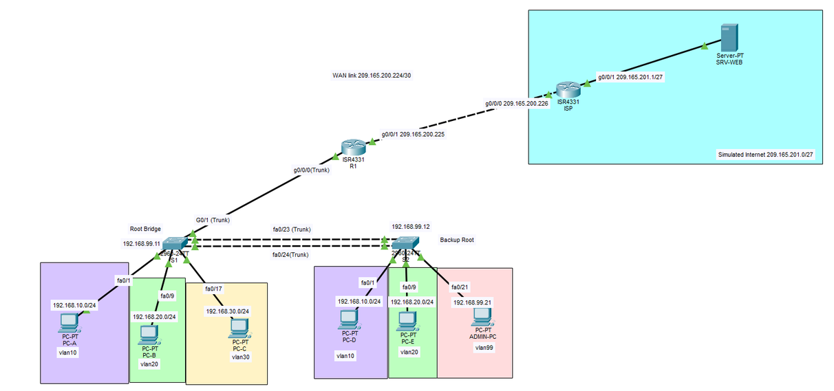
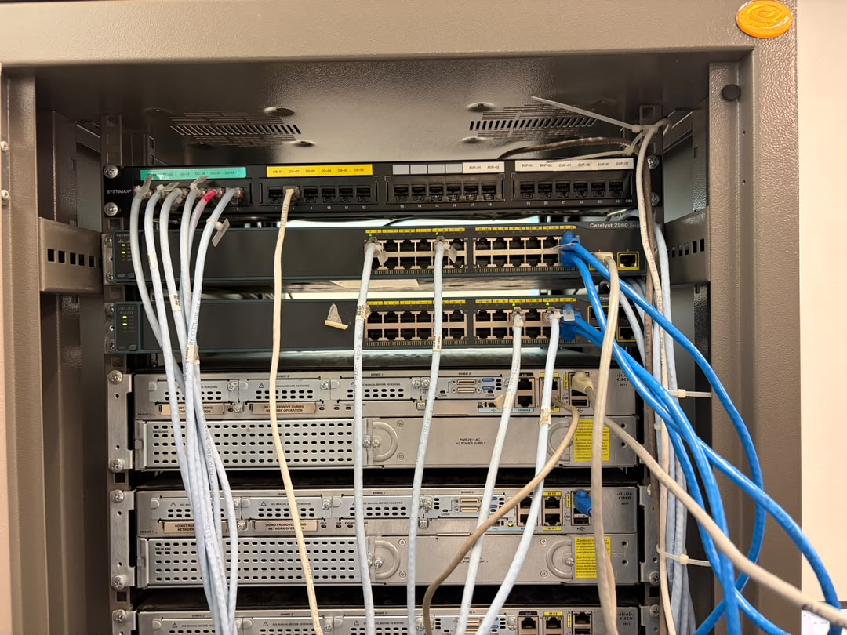
Network Topology
Two-tier design: S1/S2 access switches, R1 core router (Router-on-a-Stick + DHCP), and an ISP router simulating the internet.
Logical topology (VLANs & routing)
Physical Network Topology
IMPLEMENTATION NOTE — SIMULATION VS. PHYSICAL LAB
Packet Tracer uses 5 PCs (PC-A–PC-E) plus a web/DNS server (SRV-WEB) behind the ISP. The physical lab build uses only 4 PCs and no dedicated web server, due to limited availability of physical end devices — internet reachability on the physical hardware was verified instead by pinging the ISP router interface directly.
NET2201 · Design and Implementation of a Secure SME Network
4
Notes:
4

Slide 5
Device Roles
Device | Model | Role
R1 | Cisco ISR 4331 | Core gateway — ROAS subinterfaces, centralized DHCP, default route to ISP
ISP | Cisco ISR 4331 | Simulates the external ISP; terminates WAN link, holds return route
S1 | Catalyst 2960 | Access switch, primary STP Root Bridge; trunk to R1 + EtherChannel
S2 | Catalyst 2960 | Access switch, secondary Root Bridge; hosts Management VLAN admin host
PC-A – PC-E* | Generic PC | DHCP client test hosts across VLAN 10 / 20 / 30, on both switches
ADMIN-PC | Generic PC | Static address in VLAN 99; used to verify SSH access to all devices
SRV-WEB* | Server-PT | Simulated public web/DNS server, target for internet connectivity tests
* PC-E and SRV-WEB are used in the Packet Tracer simulation only. The physical lab build uses PC-A–D and confirms internet reachability by pinging the ISP router directly, since no physical web server was available.
NET2201 · Design and Implementation of a Secure SME Network
5
Notes:
5

Slide 6
Meeting the Minimum Requirements
Requirement | How We Met It
≥2 switches, ≥2 routers | S1, S2 access switches; R1 gateway + ISP router | ✓
4 VLANs (Staff / Student / Guest / Mgmt) | VLANs 10, 20, 30, 99 configured with /24 subnets | ✓
Centralized DHCP, gateway excluded | 3 pools on R1; first 10 addresses of each subnet excluded | ✓
802.1Q trunking, native VLAN changed | Trunks on S1–S2 and S1–R1; native VLAN moved to 100 | ✓
LACP EtherChannel + STP | Po1 (Fa0/23–24) LACP bundle; PVST+ with S1 as fixed root | ✓
≥4 access-layer security features | 8 implemented — see next slide | ✓
Hostnames, secrets, local users, SSH | Configured on all 4 network devices; Telnet disabled | ✓
Static default route + return route | R1 → ISP default route; ISP → 192.168.0.0/16 return route | ✓
Internet/DNS reachability (SRV-WEB) is fully verified in Packet Tracer; the physical lab confirms Layer-3 reachability to the ISP without the web/DNS service, due to hardware availability.
NET2201 · Design and Implementation of a Secure SME Network
6
Notes:
6

Slide 7
Testing & Verification
15 tests executed end-to-end across 5 categories — all passed in both Packet Tracer and the physical lab.
✓
✓
✓
✓
✓
DHCP & Addressing
VLANs & Routing
Redundancy
Access Security
Secure Management
T1–T2
T3–T8
T9–T11
T12–T13, T15
T14
Correct pool, gateway, DNS per VLAN; exclusions respected
Intra- and inter-VLAN connectivity, trunking, and internet reachability confirmed
EtherChannel bundled, STP root fixed, traffic survives a link failure
Port security, BPDU Guard, and unused-port quarantine all triggered correctly
SSH verified in Packet Tracer; local authentication verified in the physical lab
Full test matrix, command output, and screenshots are walked through in the demonstration video and documented in Appendix B of the report.
NET2201 · Design and Implementation of a Secure SME Network
7
Notes:
7

Slide 8
Beyond the Minimum Requirements
8 vs. 4
Redundancy by design
Deterministic topology
Security features implemented — double the required minimum (incl. PortFast + BPDU Guard)
LACP EtherChannel delivers link redundancy without a second core router
STP root bridge placement fixed manually, not left to default election
Full VLAN coverage
Documented roadmap
Scalable subnetting
5 PCs in simulation prove every VLAN — incl. Management — works on both switches
ACL on the Guest subinterface flagged as the natural next security enhancement
Each /24 supports 253 hosts; spare access ports remain on both switches
NET2201 · Design and Implementation of a Secure SME Network
8
Notes:
8

Slide 9
Troubleshooting Highlights
Real issues encountered during implementation, identified with IOS verification commands, and resolved:
Problem | How We Found It | How We Fixed It
ADMIN-PC self-assigned a 169.254.x.x address on DHCP, blocking SSH testing | show vlan bief confirmed Fa0/21 was correctly in VLAN 99; show ip dhcp pool on R1 showed VLAN 99 has no pool by design | Set ADMIN-PC to static 192.168.99.21/24, gateway .1, DNS 209.165.201.10 - matched the original design
SSH could not be configured on the physical lab switches - crypto key generate rsa was rejected | show version revealed an older IOS image with no crypto feature set; show ip ssh confirmed no SSH support | Documented the hardware limitation; applied line passwords, enable secret, local accounts + Mgmt VLAN instead; full SSH retained and demonstrated in Packet Tracer
NET2201 · Design and Implementation of a Secure SME Network
9
Notes:
9

Slide 10
Conclusion
WHAT WE ACHIEVED
  Migrated from flat network to segmented design with four VLANs and Router-on-a-Stick inter-VLAN routing
  Centralized DHCP, LACP EtherChannel redundancy, and deterministic PVST+ root bridge configured
  Applied eight access-layer security features with SSH-only management enabled
  Verified internet connectivity via simulated ISP; tested in Packet Tracer before deployment on real Cisco hardware
Watch the Full Walkthrough
Covers the physical lab setup, VLAN/trunk/routing verification, DHCP operation, ping tests, and a security feature demo.
Video link: https://youtu.be/uDCfK2LEvJc
NET2201 · Design and Implementation of a Secure SME Network
10
Notes:
10

